Slide 1
Synthesis
Workshop Session 3
Presented by
Aireen Amir Jalal

Slide 2
Contents
What is Synthesis?
Design Exploration Strategy
Basics of Timing
Timing Delays
Setup and hold time violations
Static Timing Analysis (STA)
Timing Violations
LAB PRACTICE

Slide 3
Design.v, Design.sdc, Std_cells.lef, Std_cells.lib
Input
Synthesis
Yosys, OpenSTA
Design_gate_level_netlist.v
Output
Design_gate_level_netlist.v, macro.lef, macro.cfg
Input
Floorplan/Power Network
init_fp, ioplacer, pdn
Floorplan.def
Output
Floorplan.def
Input
Placement
RePLace,OpenDP
Placement.def
Output
Open-source EDA Tools
Design_gate_level_netlist.v, Placement.def
Input
CTS
TritonCTS
CTS.def, CTS_netlist.v
Output
Input
Routing
FastRoute, TritonRoute
CTS.def
Routing.def
Output
Input
RC Extraction
SPEF-Extractor
Routing.def
Design.spef
Output
Input
GDS Generation
Magic
Input
Routing.def
Output
Output
Design.gds, Design.lef
Input
Physical Verification
APR Step
Design.gds
Magic
EDA Tool

Slide 4
What is Synthesis?
RTL
module inverter (
input wire in,
output out );
assign out = !in;
endmodule
SCL
Sky130.lef, sky130.lib
RTL
Abc.v, abc.sv
SDC
Abc.sdc
What are SCL?
Standard cell library
Collection of building blocks
Logic
Synthesis
Gate-Level Netlist
module inverter(in, out);
input in;
output out;
sky130_fd_sc_hd__inv_2 _0_ (
.A(in),
.Y(out)
);
endmodule
What is SDC?
Synopsis Design Constraint
Timing constraints in a design.
Gate-level netlist
Abc.v

Slide 5
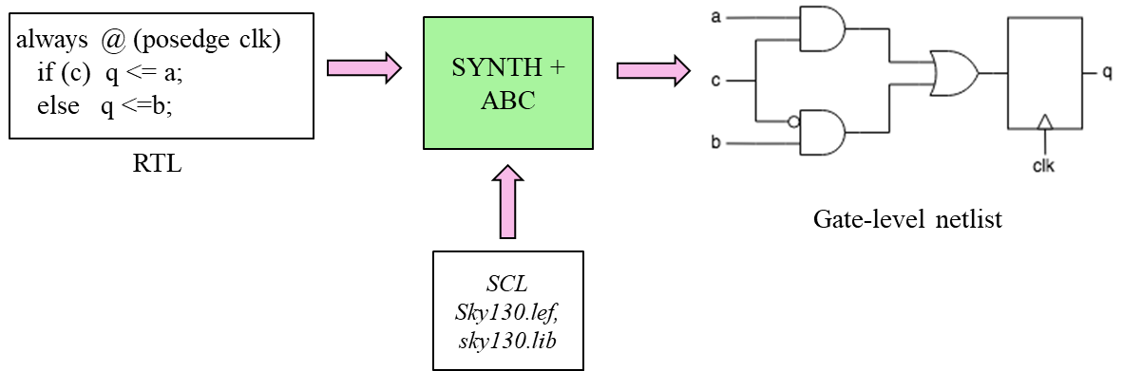
What is Synthesis?
Translation; Identifies logic,
Optimization; Technology-independent optimizations,
Mapping; Map logic elements to target technology (standard cell library).

Slide 6
Design Exploration Strategy
Trade-off between Area and Timing

Slide 7
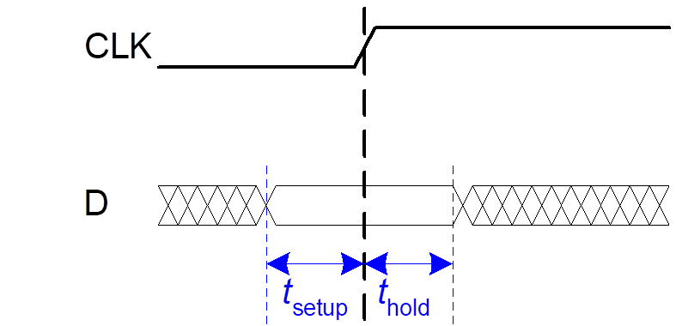
Basics of Timing
Setup time : t_{setup} = time before the clock edge that data must be stable (i.e. not changing)
Hold time: t_{hold} = time after the clock edge that data must be stable

Slide 8
Timing Delays
Main delay concerns in circuits:
Gate delays are due to gate transitions
Wire delays are due to signal propagation along wires
Clock skew is due to the difference in time the sequential elements activate.
Assume clock skew is negligible, we’ll discuss in more detail in Clock Tree Synthesis tutorial.

Slide 9
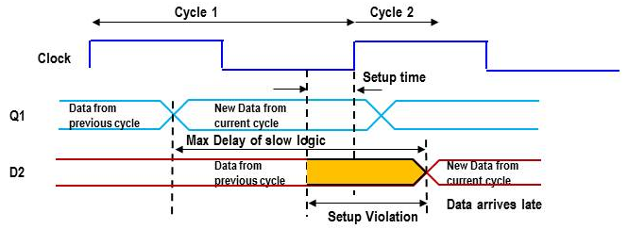
Setup time violations
Launch Flop
Capture Flop
ff1
Combinational logic
ff2
D1
Q1
D2
Q2
Setup violations can be fixed by either;
Increasing the clock period
Decreasing the delay of the data path logic
Clock
t_{Clock} ≥ t_{combDelay} +t_{setup}

Slide 10
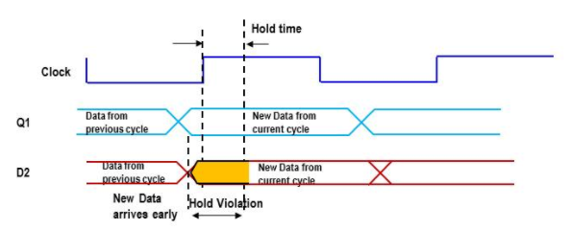
Hold time violations
Launch Flop
ff1
Combinational logic
ff2
D1
Q1
D2
Clock
t_{combDelay} ≥ t_{hold}

Slide 11
Static Timing Analysis
Here we will be looking at SLACK!
It is the difference between the Required arrival times and the actual arrival time for a signal.
Compute the slack = RAT – AAT
RAT is the required arrival time, latest time signal can transition
AAT is the actual arrival time
Negative slack at any output means the circuit does not meet timing Positive slack at all outputs means the circuit meets timing

Slide 12
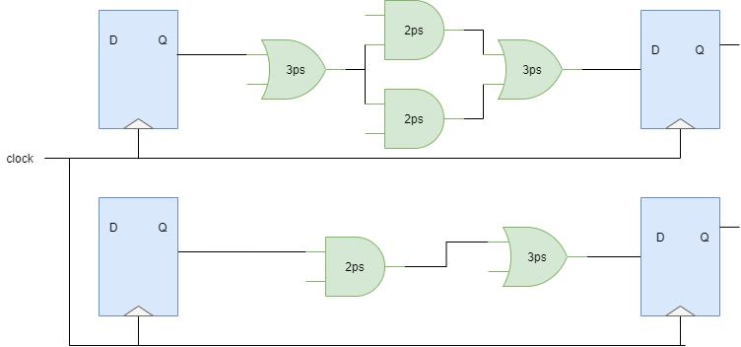
Timing Violations
Worst Negative Slack (WNS)
Data arrival time (DAT) > required arrival time (RAT)
DAT=Gate delay + Net delay = 3+2+3+Net delay > Arrival time
negative slack exists
Total Negative Slack (TNS)
Sum of all the delays
Clock period (T_{RAT}) = 5ps

Slide 13
Thank you

